Slide 1

Netflix Data Analysis Project
Somineni Sathvika
INTERNSHIP_17546440516895be537820f

Slide 2

PROBLEM STATEMENT
Netflix has become one of the most prominent global streaming platforms, continuously expanding its library with a mix of original productions and licensed content. However, with growing competition from platforms like Amazon Prime, Disney+, and regional OTT providers, Netflix must strategically analyze its content catalog to identify strengths, gaps, and opportunities.
The specific problem to be addressed in this project is 'Content Trends Analysis for Strategic Recommendations'. The aim is to uncover how Netflix’s content distribution (Movies vs. TV Shows, genres, and country contributions) has evolved over the years. This will enable the identification of key genres, audience preferences, and strategic insights into global content expansion.

Slide 3
Project Description This project focuses on analyzing the Netflix dataset to identify content trends and provide strategic recommendations. Using a dataset of 7,789 records covering Movies and TV Shows between 2008–2021, the analysis explores: The balance between Movies and TV Shows over the years. Genre trends and their evolution. Country-wise contributions to Netflix’s catalog. Distribution of content ratings and leading directors. The results highlight how Netflix has expanded internationally, which genres are most popular, and where future opportunities lie. Insights from this analysis can guide Netflix in making data-driven decisions about content acquisition, production, and regional strategies.

Slide 4

WHO ARE THE END USERS?
Netflix Management & Content Strategy Teams → To make data-driven decisions about content acquisition and production.
Media & Entertainment Analysts → To study trends in OTT streaming and competition.
Investors & Business Stakeholders → To understand Netflix’s growth strategy and market positioning.
Students & Researchers → For learning data analytics and real-world application in OTT industry case studies.

Slide 5

Technology Used
Python (Pandas, NumPy) → Data cleaning and analysis
Matplotlib → Data visualization and graphs
Google Colab / Jupyter Notebook → Running analysis interactively
PowerPoint → Presenting insights with charts and recommendations
GitHub → Hosting the project repository and version control

Slide 6
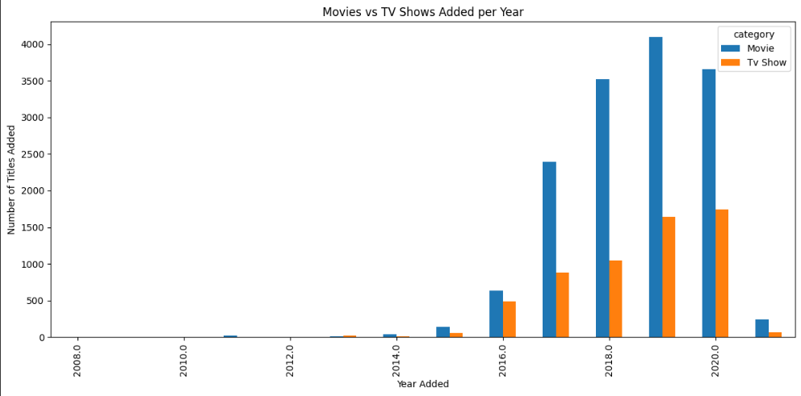
RESULTS1

Slide 7
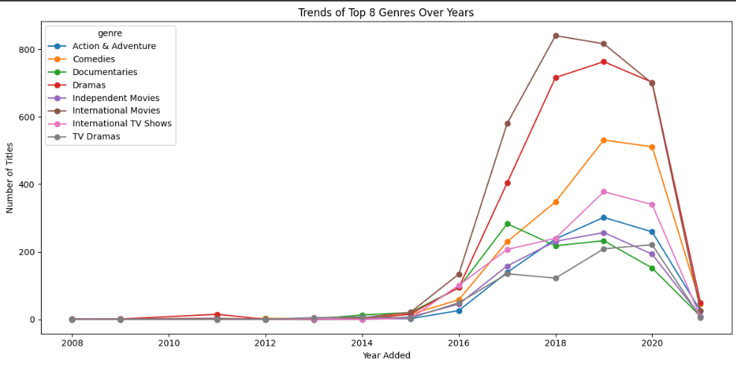
RESULTS2

Slide 8
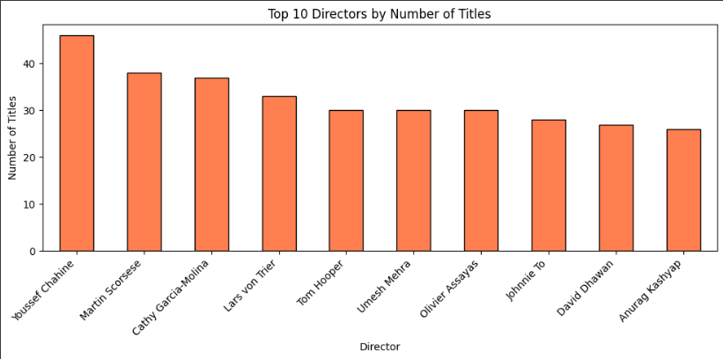
RESULTS3

Slide 9
GitHub repository
https://github.com/SathvikaSomineni/VOIS_AICTE_Oct2025_MajorProject_Sathvika

Slide 10
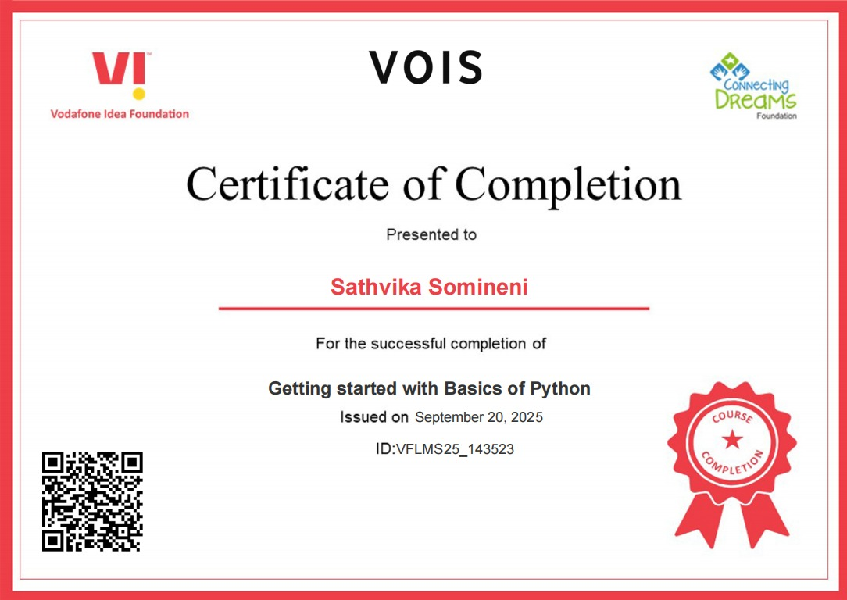
Getting started with Basics of Python Certificate

Slide 11
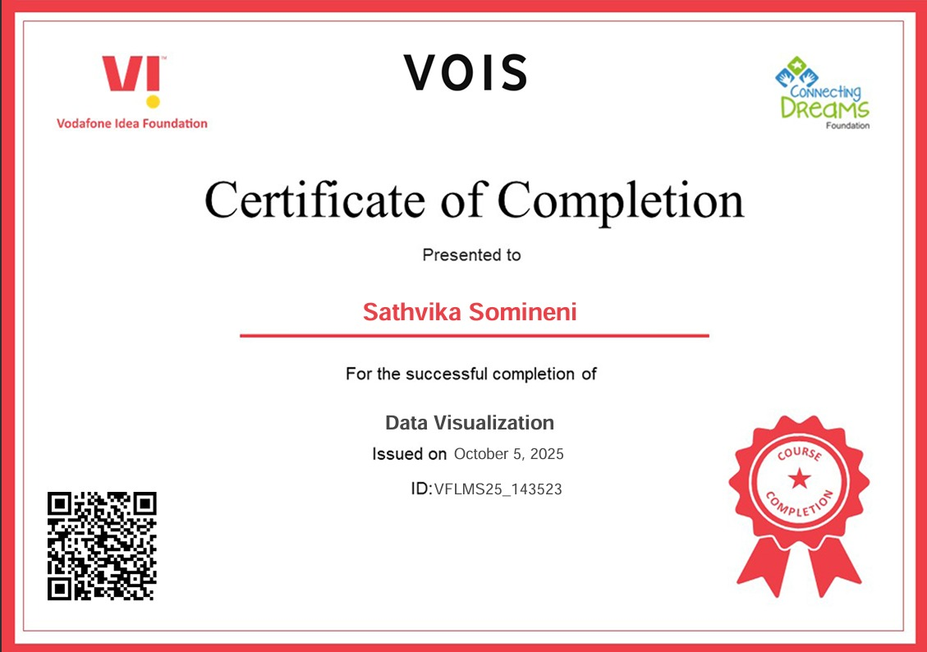
Data Visualization Certificate

Slide 12
Thank you
.
.

